Slide 1
MSF 502 : Hypothesis Testing
—>
Ruthwik Reddy Vibhuti
Nithik Roshan Tanvi

Slide 2
A Case Study on Nvidia Stock Price Prediction
We have built two Linear Regression Models to predict the stock price of Nvidia.
And Our goal is to evaluate the performance of two linear regression models for predicting Nvidia stock prices.

Slide 3
Linear Regression :
Linear regression is a statistical method used to model the relationship between a dependent variable (target variable) and one or more independent variables (predictor variables).
In the context of predicting Nvidia stock prices, the dependent variable (Y) would be the Close price, while the independent variables (X) could include factors such as opening price, closing price, volume, etc.

Slide 4
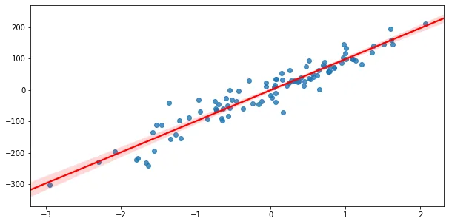


Model A:
Model B :
Using, MSE(Mean Squared Error) we optimize the weights.

Slide 5
Hypothesis Testing :
Null Hypothesis :
There is no significant difference in performance of linear regression models Model_A and Model_B.
Alternate Hypothesis:
Ha : Model B Outperforms than Model A [--> One tailed Test]

Slide 6
Population :
In the context of hypothesis testing for stock price prediction, the historical and future stock prices of Nvidia would be be the population.
Sample :
A subset of historical stock price data of Nvidia ( 27th Oct - 31 Dec 2023)

Slide 7

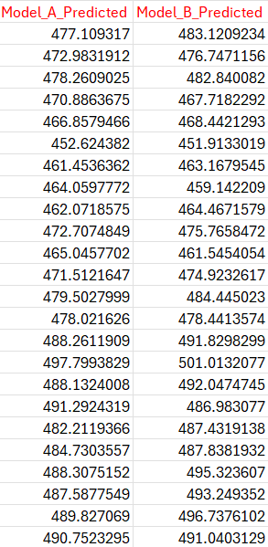

Slide 8
Test Statistics:
Paired T-test :
In the context of comparing the performance of two linear regression models, the paired t-test is used when there is a natural pairing or connection between the observations in the two groups being compared.
T-Test Value = -2.07
Critical value for alpha(0.05) = -1.71

Slide 9
Inference :
Since, T-test < Critical Value
We reject the null hypothesis stating that there is no significant difference in performance of linear regression models.
>> The alternative hypothesis is supported, suggesting that Model B performs better than Model A.
>> Implying that incorporating "Low" and "Volume" variables into the linear regression model resulted in improved performance.

Slide 10
Thank You !

